Slide 1

Department of Computer Science and Engineering
Improving Passenger Experience: Predicting Airline Delays
Through Machine Learning
PRESENTED BY
K. Venkata Naveen (21471A05N1)
P. Ashok (22475A0511)
M. Rishik Mouli (21471A05N5)
Under the Guidance of,
Dr. S. Siva Nageswara Rao_{M. Tech., Ph.D.},
Professor,
Department of Computer Science and Engineering,
Narasaraopeta Engineering College (Autonomous),
Narasaraopet - 522 601.

Slide 2
OUTLINE
Abstract
Introduction
Literature Survey
Research Gaps
Problem Statement
Objectives
Methodology
System Requirements
Results and Analysis
Conclusion & Future Scope
References

Slide 3
ABSTRACT
This study presents a Improving Passenger Experience: Predicting Airline Delays Through Machine Learning using Bureau of Transportation Statistics Historical dataset, integrating advanced feature engineering and Machine learning models. Like traditional regression models and random forest and support vector machine
By incorporating features like weather ,distance, and air traffic, the proposed approach achieves more accurate predictions. Experiments demonstrate that removing outliers significantly enhances model performance.
This research provides a reliable tool for personalized the passenger experience the impact of advanced data science techniques in airlines.

Slide 4
LITERATURE SURVEY
No | Title | Author | Journal Name & Year | Methodology Adapted | Key Findings | Gaps
1 | Selection of Best Machine Learning Model to Predict Delay in Passenger Airlines | Parita ozaa, Sudeep Tanwar . | IEEE, 2023 | The paper explores various machine learning models to predict delays in passenger airlines. | Model comparison and Feature importance and predicting the accuracy and also used different advanced models | Potential application for pediatricians and parents, further improvement by adding more features and using different datasets
2 | A Multi-Agent Approach for Reactionary Delay Prediction of Flights | The paper was written by Y. Guleria, Q. Cai, S. Alam, and L. Li, | IEEE, 2020 | The authors proposed a multi-agent approach to predictreactionary delays in flights. They used a six-month ADS-B dataset collected in 2016 to test their model. | The classification results showed an average accuracy of 80.7% in predicting delayed or un-delayed flights, with a delay classification threshold of 15 minutes. | While the paper demonstrates a promising approach to predicting flight delays, some potential gaps in the research include: scalability, simplifying assumption.
3 | Global Modeling Pruning Ensemble Stacking With Deep Learning and Neural Network Meta-Learner for Passenger Train Delay Prediction | S. Tseng et al., | IEEE, 2022 | Utilized a global modeling pruning ensemble stacking approach with deep learning and neural network meta-learner. | mean absolute error of 4.23 minutes and mean squared error of 35.17 minutes | Limited generalizability to other transportation modes

Slide 5
No | Title | Author | Journal Name & Year | Methodology Adapted | Key Findings | Gaps
4 | Personalized Flight Recommender System Based on Link Prediction in Aviation Data | J. Liu et al., | IEEE, 2020 | Utilized link prediction techniques and graph-based algorithms to develop a personalized flight recommender system. | Achieved an average precision of 83.2% and recall of 81.5% in recommending flights to users.. | Limited consideration of real-time flight data and lack of incorporation of additional user preferences and behaviors.
5 | Term Arrival Delay Time Prediction in Freight Rail Operations Using Data-Driven Models | S. Wang et al., | Transportation Research Record, 2019. | Utilized data-driven models, including ARIMA, LSTM, and GRU, to predict terminal arrival delay times in freight rail operations. | mean absolute error of 2.37 hours and a mean squared error of 10.51 hours in predicting arrival delay times. | Limited consideration of external factors, such as weather and traffic conditions.
6 | Prediction of flight delay using deep operator network | Y. Zhang et al., | IEEE 2020 | Utilized Deep Operator Network (DON) to predict flight delays by learning complex relationships between flight-related factors. | mean absolute error of 12.5 minutes. | Limited interpretability of the DON model and lack of consideration

Slide 6
LITERATURE SURVEY
Traditional Statistical Models:
Linear regression and classical statistical models have been widely used for airline delay prediction, using real-time historical data.
These approaches face limitations in accuracy due to large dataset
Machine Learning Techniques:
More recent studies have employed machine learning models like Support Vector Machines (SVMs) and Random Forests to enhance prediction accuracy.
While these models outperform traditional methods, they often struggle with overfitting and require extensive feature engineering.

Slide 7
LITERATURE SURVEY
Deep Learning Applications:
Emerging deep learning frameworks leverage neural networks to automatically extract relevant features from large datasets.
These approaches demonstrate significant improvements in accuracy, adaptability, and scalability compared to traditional models.
Gaps in Existing Research:
Limited consideration of real-time data: Most studies rely on historical data, neglecting the importance of real-time information in predicting flight delays.
Many machine learning models are complex and difficult to interpret, making it challenging to understand the relationships between variables.

Slide 8
RESEARCH GAPS
Limited consideration of data quality and reliability: Existing research often overlooks the data quality and reliability issues that can impact model performance and accuracy. Many models are not tested on a wide variety of people or real-world situations, which raises questions about their reliability.
Existing models often rely on batch processing and fail to incorporate real-time monitoring and updating.

Slide 9
PROBLEM STATEMENT
Flight delays are a significant challenge for airlines, causing customer dissatisfaction and operational inefficiencies. Accurately predicting delays is complex due to high-dimensional data and numerous influencing factors like weather, traffic, and scheduling. Existing methods often lack the precision needed for real-time decision-making. This project aims to leverage machine learning models to enhance the accuracy and reliability of flight delay predictions, thereby improving airline operations and passenger experience.

Slide 10
OBJECTIVES
To analyze and preprocess a large-scale flight dataset, including handling missing values, feature engineering, and normalization, to ensure data quality.
To evaluate various machine learning models—SVM, Random Forest, Decision Tree, and Linear Regression—for their effectiveness in predicting flight delays.
To explore future enhancements by integrating real-time data and advanced algorithms for greater predictive accuracy and adaptability.

Slide 11
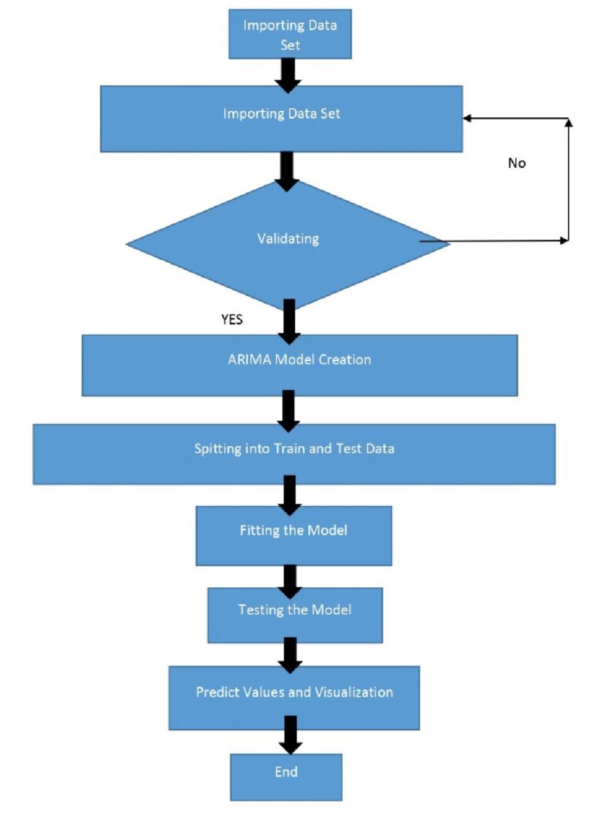
BLOCK DIAGRAM OR FLOW DIAGRAM

Slide 12
METHODOLOGY
Preprocessing steps:
Data Cleaning: Removed outliers from Bureau of Transportation Statistics dataset to improve data quality and model reliability.
Feature Engineering: Created additional features, such as average distance, traffic, and peak hours.
Missing Value Handling: Addressed missing data points using imputation techniques to maintain dataset completeness.
Scaling and Normalization: Scaling and normalization can improve model performance and reduce the risk of overfitting.
Data Splitting: Divided the dataset into training and testing sets to evaluate model performance accurately.

Slide 13
System Requirements
Hardware Requirements
Processor : intel Core i5
Cache memory : 4MB(Megabyte)
RAM : 12.7GB (gigabyte)
Hard Disk : 166.8GB
Compute Engine : T4 GPU
Software Requirements
Operating System : Windows 10, 64-bit OS
Coding Language : Python
Python distribution : Google Colab Pro , Flask
Browser : Any Latest Browser like Chrome

Slide 14
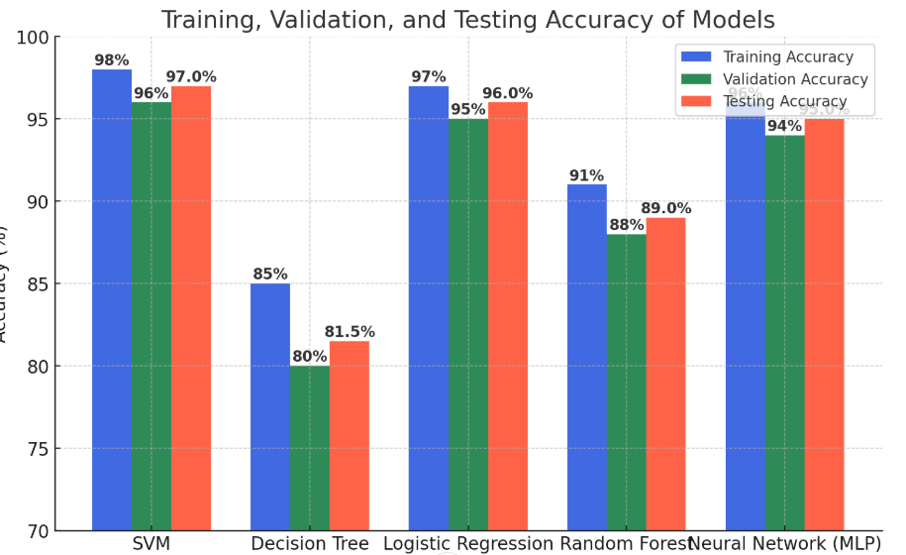
RESULTS & ANALYSIS
The chart compares model accuracy after outlier removal, showing an increase in accuracy across all models.
Support Vector Machine has the highest accuracy improvement, while other models also shows noticeable gains.

Slide 15
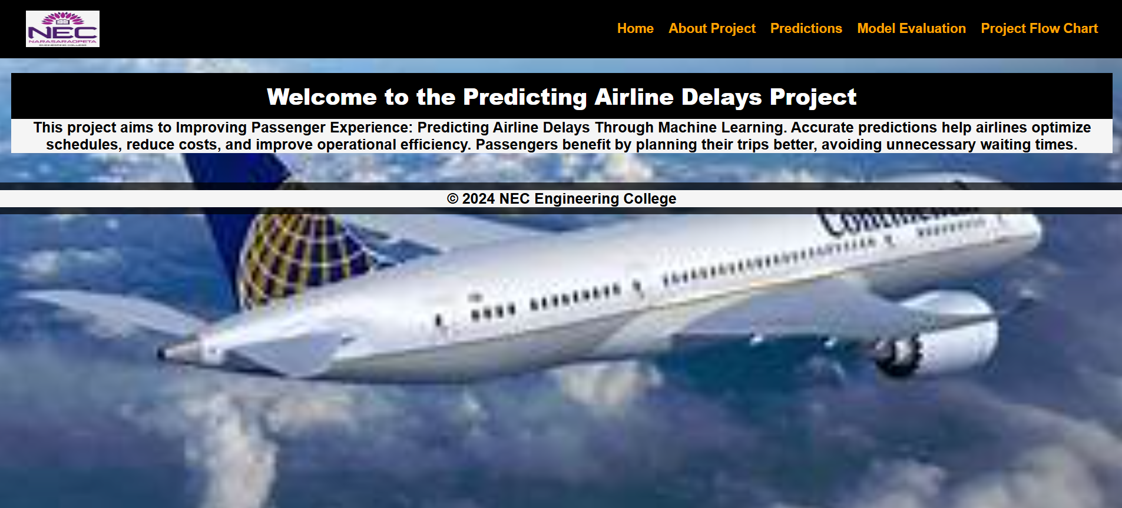
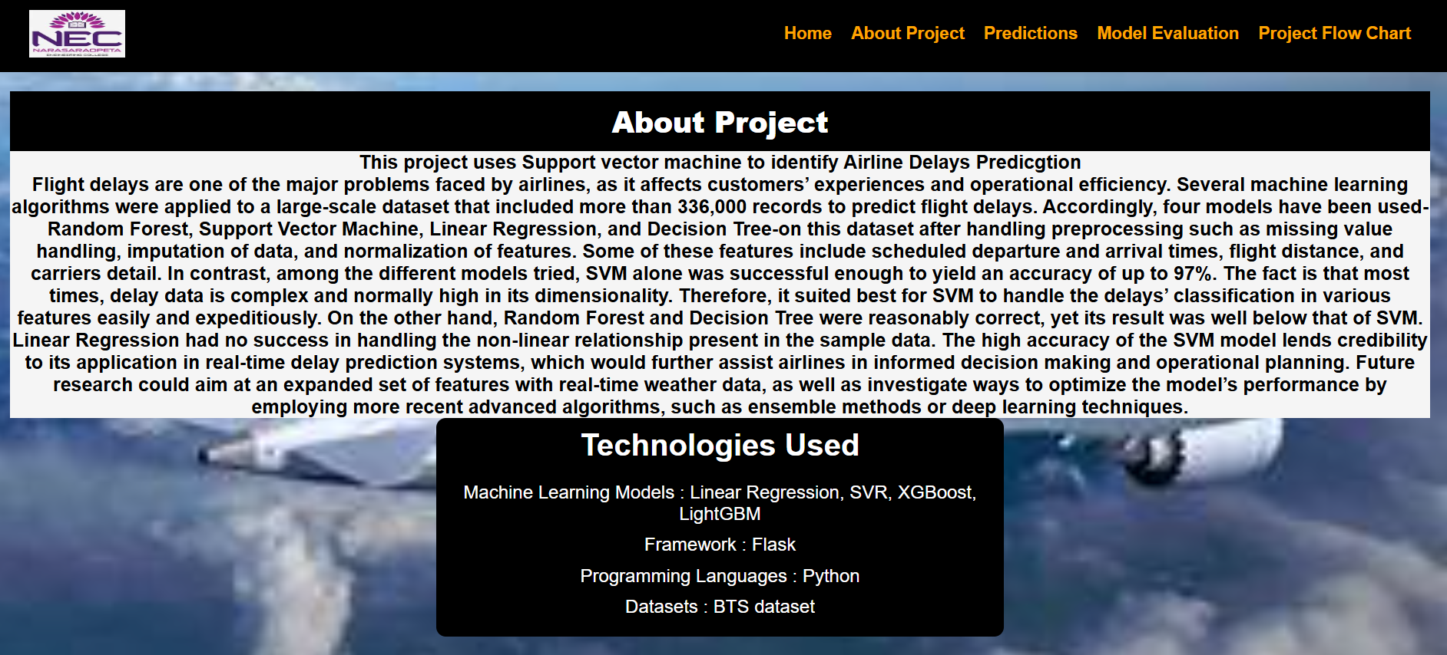
Output screens

Slide 16
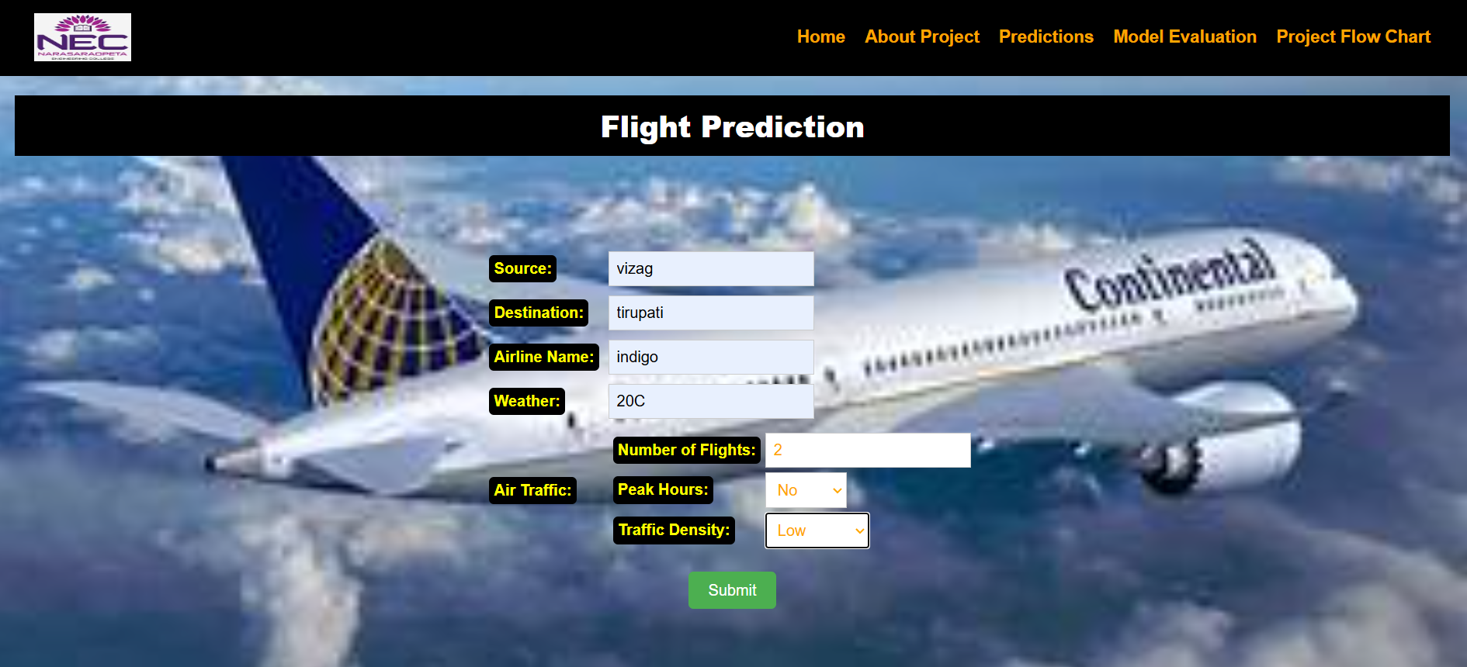
Prediction

Slide 17
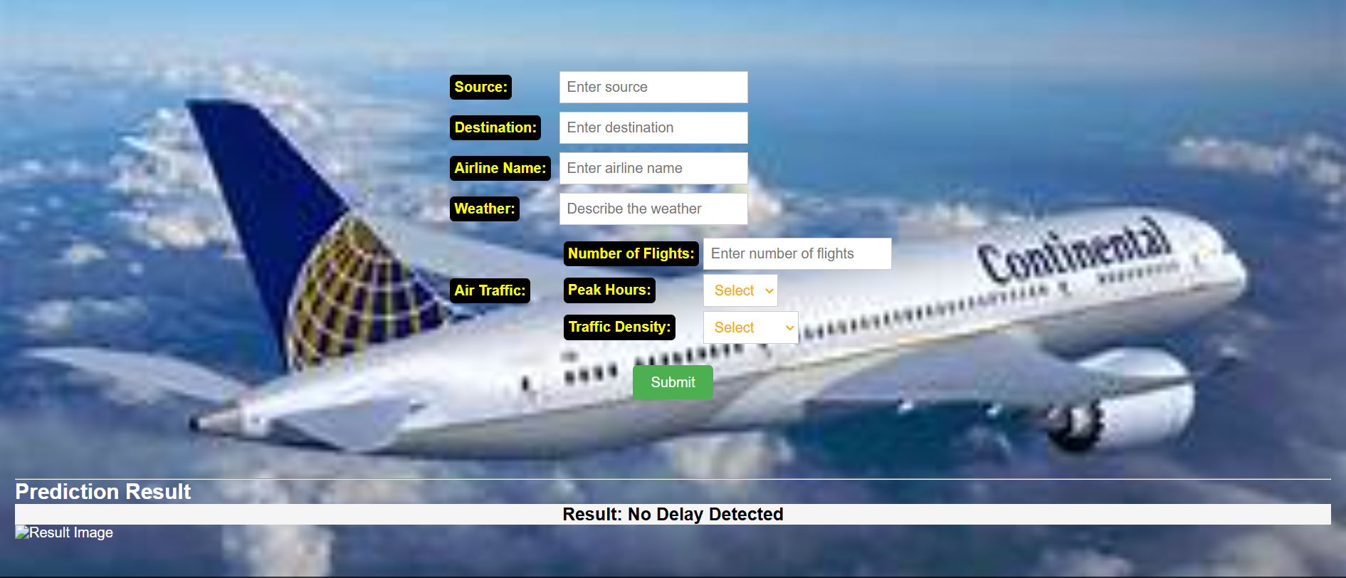
Result

Slide 18
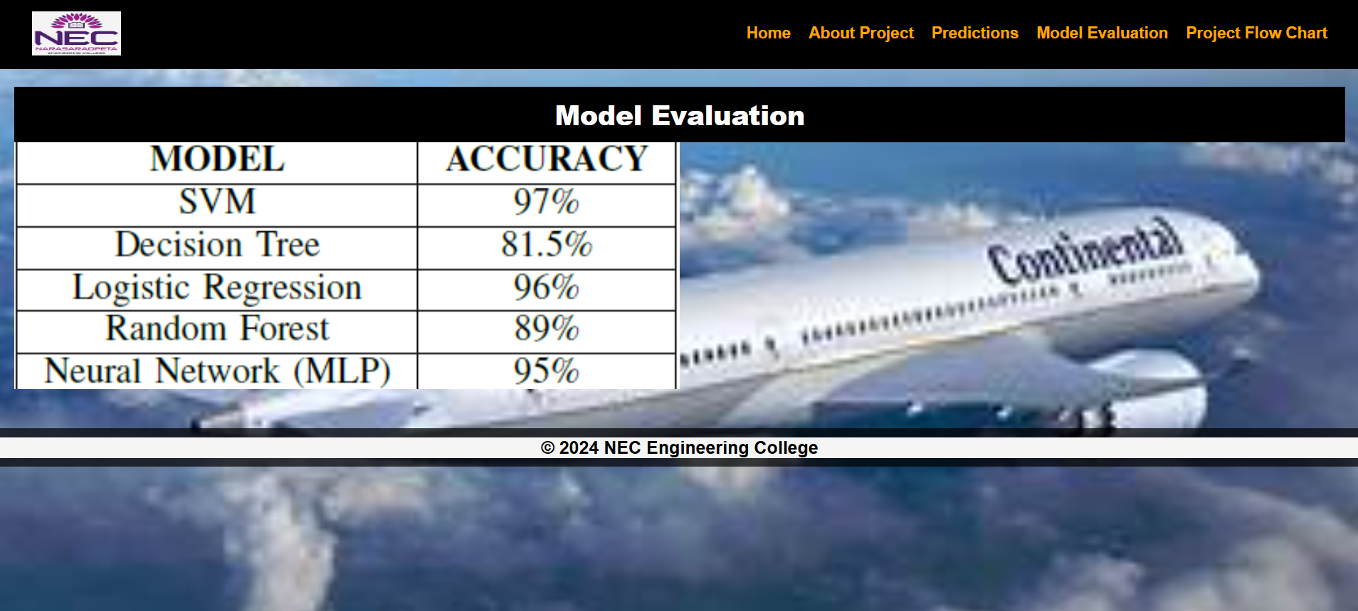
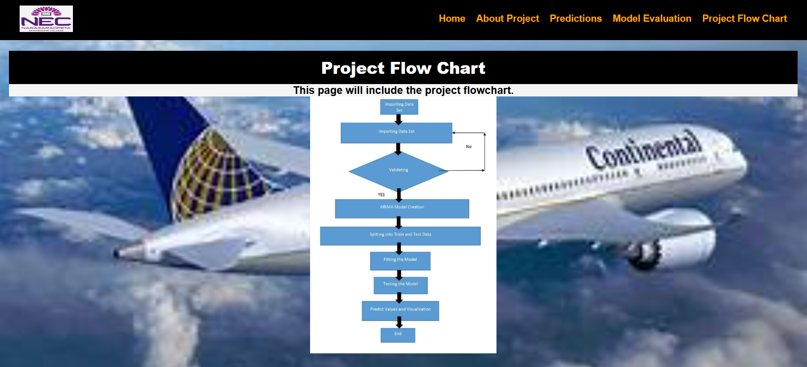
Prediction table & Flowchart

Slide 19
CONCLUSION & FUTURE SCOPE
The study demonstrates the importance of flight delay prediction, reduces operational costs and improving passenger experience .
Outlier removal and feature engineering and removing none and null values significantly boosted model accuracy.
Modern Machine learning models like SVM outperformed this model given highest accuracy 97% among the all models.
Expanding the dataset to include diverse ethnic groups and geographical variations.

Slide 20
REFERENCES
[1] Lapamonpinyo, P., Derrible, S., Corman, F. (2022). Real-time passengertrain delay prediction using machine learning: A case study with Amtrak passenger train routes. IEEE Open Journal of Intelligent TransportationSystems, 3, 539-550.
[2] Bisandu, D. B., Moulitsas, I. (2024). Prediction of flight delay using deep operator network with gradient-mayfly optimisation algorithm. Expert Systems With Applications, 247, 123306.
[3] Zhang, D., Peng, Y., Zhang, Y., Wu, D., Wang, H., Zhang, H. (2021). Train time delay prediction for high-speed train dispatching based on spatio-temporal graph convolutional network. IEEE Transactions on Intelligent Transportation Systems, 23(3), 2434-2444.
[4] Lykou, G., Dedousis, P., Stergiopoulos, G., Gritzalis, D. (2020). Assessing interdependencies and congestion delays in the aviation network. Ieee Access, 8, 223234-223254.

Slide 21
REFERENCES
[5] Zhang, H., Liang, S., Han, Y., Ma, M., Leng, R. (2020). A prediction model for bus arrival time at bus stop considering signal control and surrounding traffic flow. IEEE Access, 8, 127672-127681.
[6] Pineda-Jaramillo, J., Bigi, F., Bosi, T., Viti, F., D’ariano, A. (2023). Short-term arrival delay time prediction in freight rail operations using data-driven models. IEEE Access, 11, 46966-46978.
[7] Boateng, V. A., Yang, B. (2023). A global modeling pruning ensemble stacking with deep learning and neural network meta-learner for passenger train delay prediction. IEEE Access, 11, 62605-62615.
[8] Guleria, Y., Cai, Q., Alam, S., Li, L. (2019). A multi-agent approach for reactionary delay prediction of flights. IEEE Access, 7, 181565-181579.

Slide 22


Slide 23


